Slide 1
LambdaNetworks:Modeling Long Range Interactions Without Attention
Annonymous authors
under double-blind review at ICLR

Slide 2
Introduction&Previous work
Modeling Long Range Interactions
Lambda Layer
实验结果
Conclusion

Slide 3
Previous Work——Transformer
用于modeling long-range interactions
NLP领域提出：BERT, GPT
应用缺陷：quadratic memory footprint of self-attention
e.g. 一批256个 64×64图象输入,8 heads需要32G内存
long sequences&multidimensional inputs such as images

Slide 4
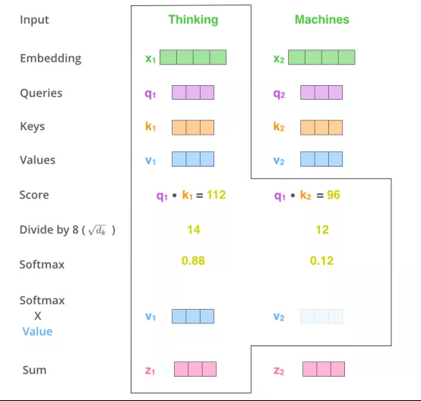
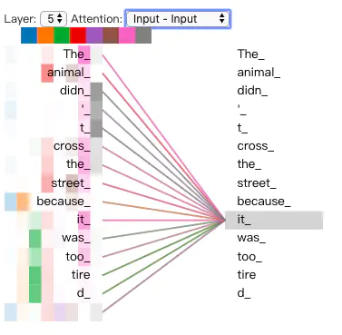

Slide 5
Introduction
capture long-range interactions between an input and structured contextual information(e.g. a pixel surrounded by other pixels)
by transforming available contexts into linear functions,termed lambdas, and applying these linear functions to each input separately.
outperforms the convolutional and attentional counterparts while being more computionally efficient

Slide 6
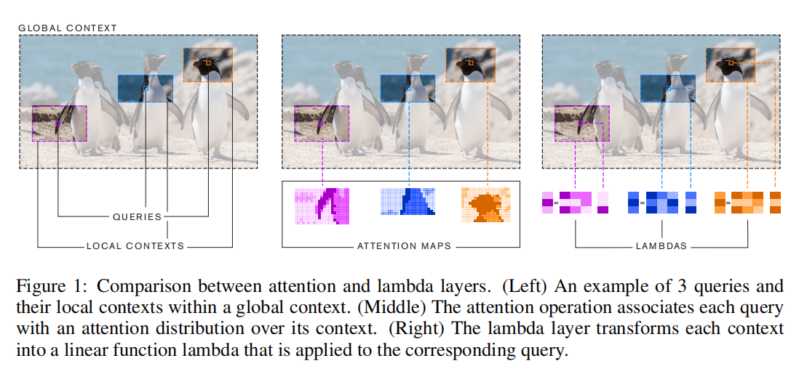

Slide 7




Defining queries,contexts and interactions
queries and the context characterized by content and position
general problem:
type of interactions:
content-based interaction
position-based interaction
introducing keys: 基于内容的key
positional embedding

Slide 8
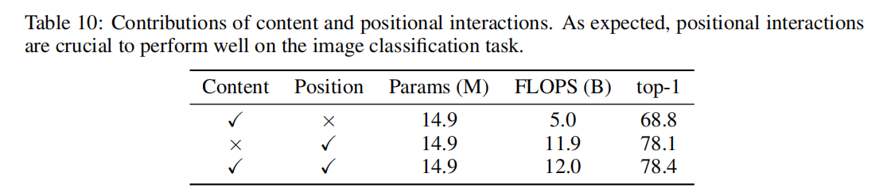
content and position-based interactions

Slide 9
Attention interactions vs.Lambda interactions
Attention interactions:
create a similarity kernel between the query and context elements
当context元素个数m增长时，input与output的维度k,v不变
v<<m时，可以假定计算attention maps的工作浪费算力
Lambda interactions:
the context is aggregated into a fixed-size linear function
exist independently of the context and is discarded after being applied to its associated query(reminiscent of lambda-calculus)

Slide 10
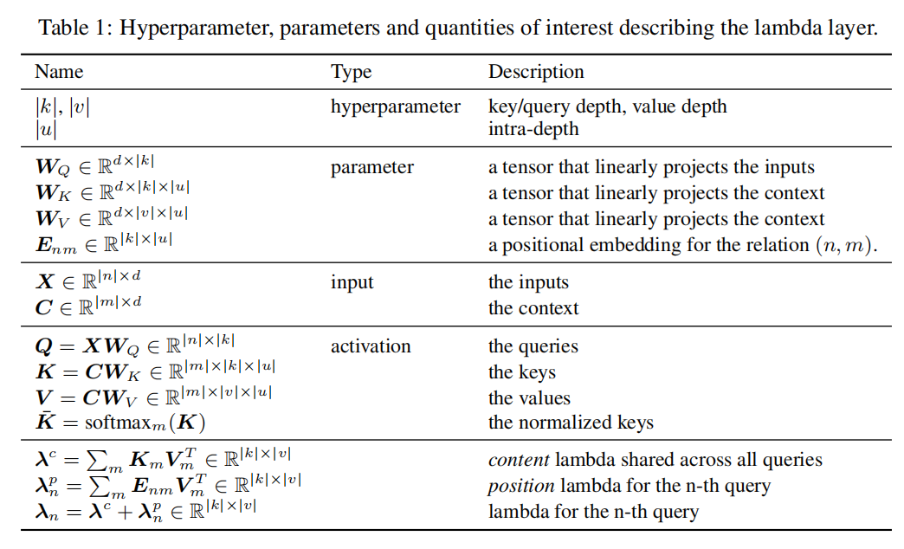
Structure of lambda layers

Slide 11
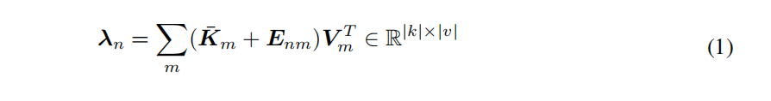
Lambda Layers
(invariant to permutation )

Slide 12
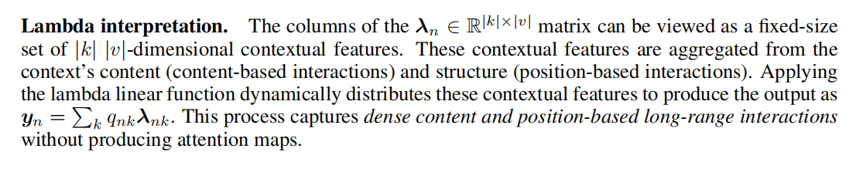
Lambda Interpretation

Slide 13
Reducing Complexity with Multiquery Lambdas
不使用multiquer的复杂度情况：

Slide 14
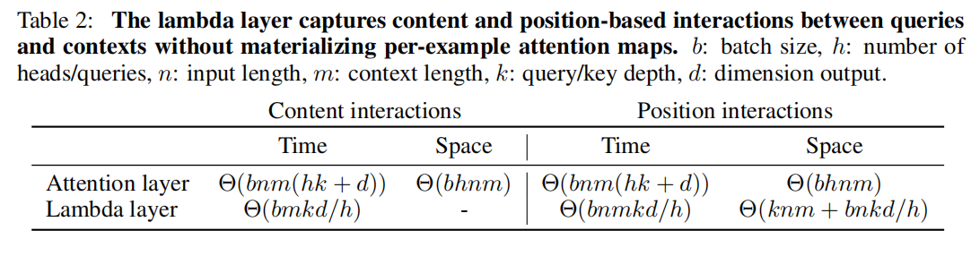
Reducing Complexity with Multiquery Lambdas
与multi-head attention不同，增加multiquery机制
可以降低复杂度而非提高
Notes:
We still have a quadratic memory footprint with respect to the
input length due to the Enm parameters that capture position-based interactions. However this
quadratic term does not scale with the batch size as is the case with the attention operation which
produces per-example attention maps. In practice, the hyperparameter |k| is set to a small value
(such as |k|=16) and we can process large batches of large inputs in cases where attention cannot

Slide 15
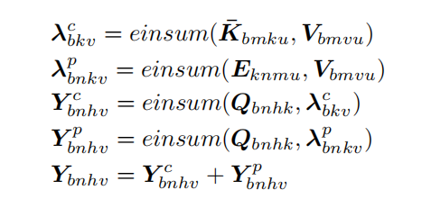
Batched multiquery implementation with einsum
The einsum operation denotes general contractions between tensors of arbitary dimensions.(numerically equivalent to broadcasting)

Slide 16
与Linear Attention的区别
Linear attention:
approximate the attention kernel by leveraging a low-rank factorization of the attention maps
do not consider position-based interactions
Lambda layers:
can model position-based interactions
allow for more non-linearities and normalizations
multiquery lambdas instead of multihead

Slide 17
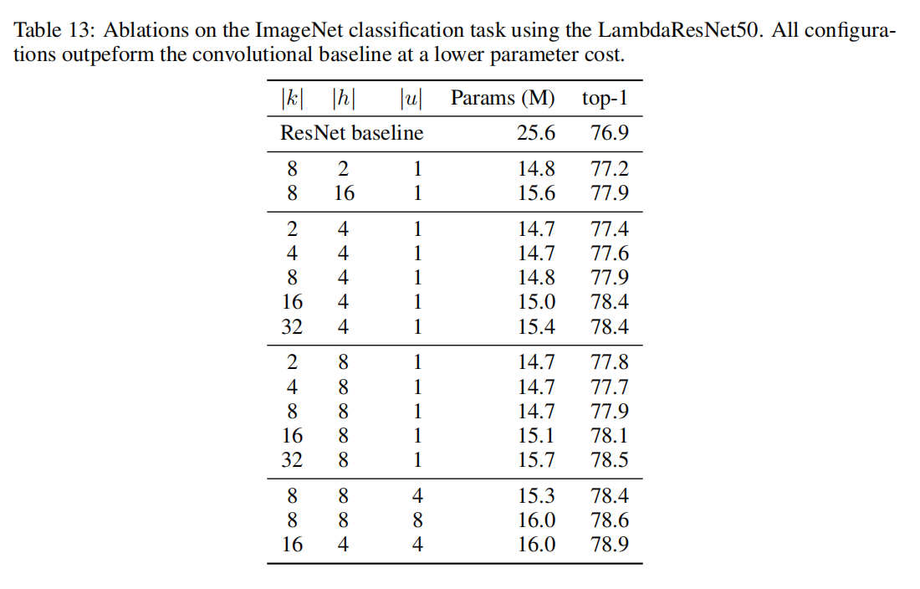
参数设置的讨论
提升query depth 或 intra-depth都可以提高模型性能
存在最佳的query head 数
过高时显著降低value depth
过低时translate to too few queries

Slide 18
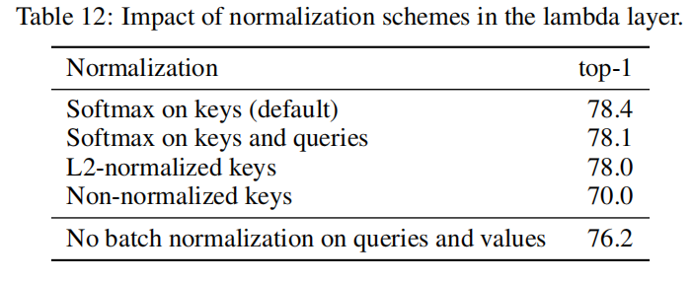
Normalization讨论
Normalizing keys is crucial
other normalization functions
batch normalization

Slide 19
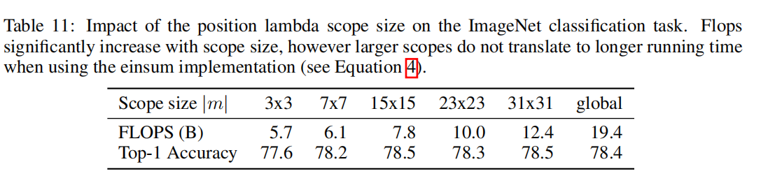
图片大小的重要性
enable considering global contexts
accuracies whe varying scope sizes
benefits from using larger scopes
validate the long-range actions

Slide 20
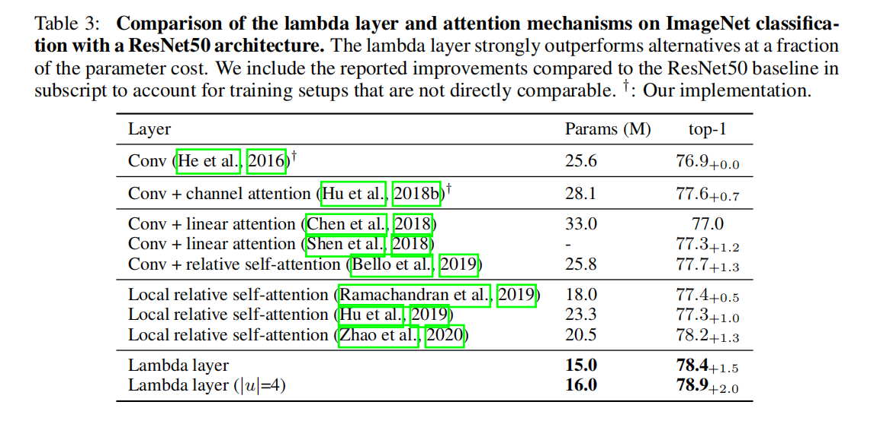
实验结果与对比——参数量

Slide 21
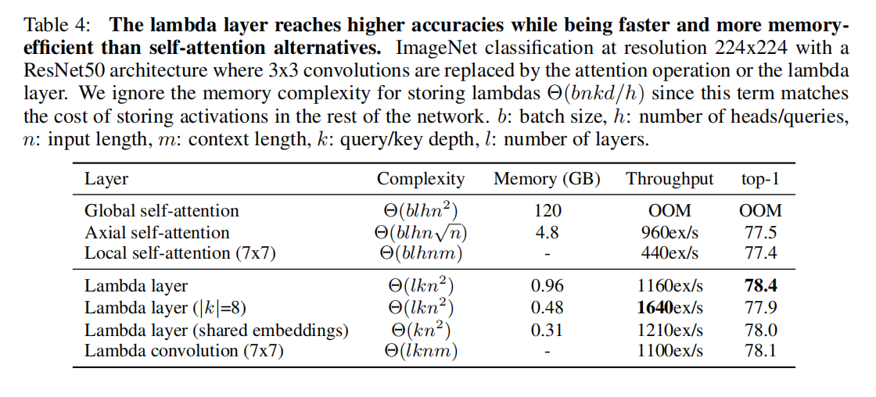
实验结果与对比——内存与吞吐量

Slide 22
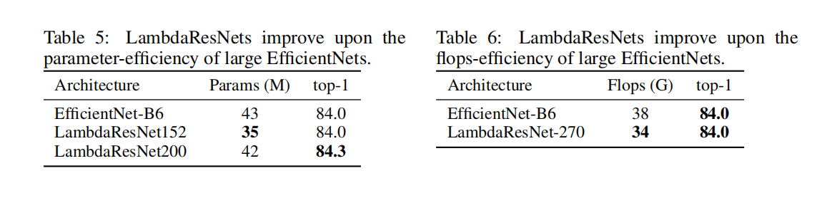
实验结果与对比——计算效率vs.EfficientNets

Slide 23
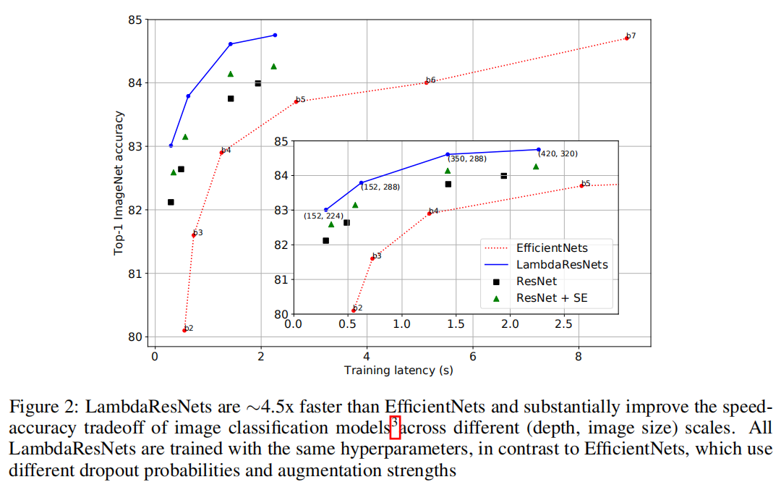
Notes:
We construct LambdaResNets by replacing the 3x3 convolutions in the ResNet architec_x0002_ture (He et al., 2016). Unless specified otherwise, all lambda layers use |k|=16, |h|=4 and |u|=1
with a scope size of |m|=23x23 and are implemented using the einsum implementation (Equation 4).

Slide 24
Versatility
masked context e.g.denoising tasks or auto-regressive training
hybrid lambdanetworks e.g. LambdaResNets
Graphs, time series,spatial lattices, object detections

Slide 25
Conclusion
Lambda layers——a general and scalable framework
summarize availble contexts into fixed-size linear functions,i.e. lambdas
directly applied to the associated query
Lambdanetworks
LambdaResNets
SOTA
significantly improve the speed-accuracy tradeoff

